Slide 1

Cash and A/R Part 1 – In-Class

Slide 2
Accounts Receivable

Slide 3
Accounts Receivable
Accounts receivable are promises of the purchaser to pay for goods and services (open lines of credit).
Usually short-term period, no interest, based on invoices (informal)
Initial measurement of receivables (amount of the sale) may be affected by the availability of discounts.
Trade or volume discounts (up next)
Sales discounts (also called cash discounts, cover on Wednesday)

Slide 4
Accounting for Uncollectibles

Slide 5
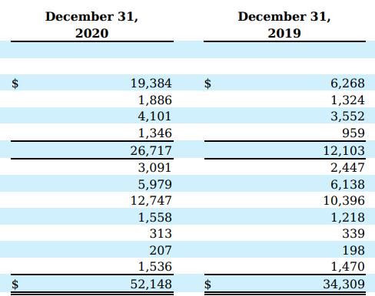
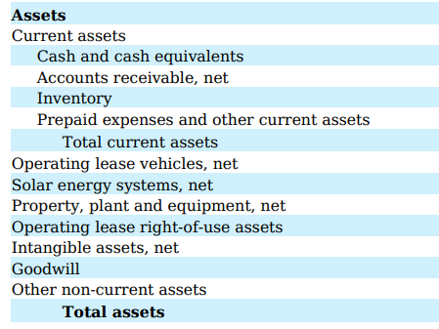
Tesla
Net?

Slide 6
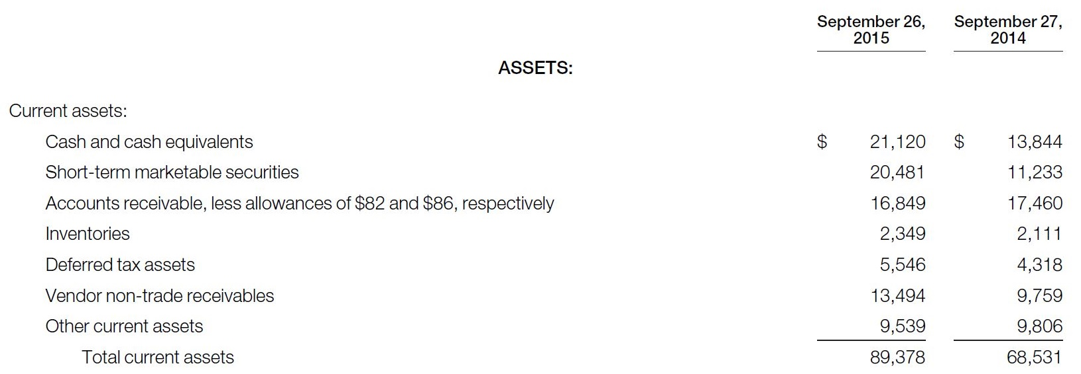

Excerpt from Apple’s Balance Sheet
What are allowances?

Slide 7
The problem…
A/R Ledger (B-A)
Customer Name | Balance Owed
Homer Corp. | 10,000
Shem Manufacturing | 10,000
Miah Inc. | 10,000
…
…
…
Keller Kompany | 10,000
Total | $5,000,000
We know some of these customers won’t pay…

Slide 8
The problem…
A/R Ledger (B-A)
Customer Name | Balance Owed
Homer Corp. | 10,000
Shem Manufacturing | 10,000
Miah Inc. | 10,000
…
…
…
Keller Kompany | 10,000
Total | $4,980,000
If we know which ones won’t pay, we can get rid of them.

Slide 9
The problem…
A/R Ledger (B-A)
Customer Name | Balance Owed
Homer Corp. | 10,000
Shem Manufacturing | 10,000
Miah Inc. | 10,000
…
…
…
Keller Kompany | 10,000
Total | $4,980,000
And A/R will be stated at the amount we expect to collect.

Slide 10
The problem…
A/R Ledger (B-A)
Customer Name | Balance Owed
Homer Corp. | 10,000
Shem Manufacturing | 10,000
Miah Inc. | 10,000
…
…
…
Keller Kompany | 10,000
Total | $4,980,000
That’s good.

Slide 11
The problem…
A/R Ledger (B-A)
Customer Name | Balance Owed
Homer Corp. | 10,000
Shem Manufacturing | 10,000
Miah Inc. | 10,000
…
…
…
Keller Kompany | 10,000
Total | $5,000,000
BUT…we usually don’t know which ones won’t pay.

Slide 12
The problem…
A/R Ledger (B-A)
Customer Name | Balance Owed
Homer Corp. | 10,000
Shem Manufacturing | 10,000
Miah Inc. | 10,000
…
…
…
Keller Kompany | 10,000
Total | $5,000,000
Leaving our A/R at $5M would OVERSTATE our assets.

Slide 13
The problem…
A/R Ledger (B-A)
Customer Name | Balance Owed
Homer Corp. | 10,000
Shem Manufacturing | 10,000
Miah Inc. | 10,000
…
…
…
Keller Kompany | 10,000
Total | $5,000,000
That’s bad.

Slide 14
The problem…
A/R Ledger (B-A)
Customer Name | Balance Owed
Homer Corp. | 10,000
Shem Manufacturing | 10,000
Miah Inc. | 10,000
…
…
…
Keller Kompany | 10,000
Total | $5,000,000
What do we do?

Slide 15
The problem…
A/R Ledger (B-A)
Customer Name | Balance Owed
Homer Corp. | 10,000
Shem Manufacturing | 10,000
Miah Inc. | 10,000
…
…
…
Keller Kompany | 10,000
Total | $5,000,000
Suppose we know two customers won’t pay, on average.

Slide 16
Allowance Method
A/R Ledger
Allowance for Doubtful Accounts (B-XA)
Customer Name | Balance Owed
Homer Corp. | 10,000
Shem Manufacturing | 10,000
Miah Inc. | 10,000
…
…
…
Keller Kompany | 10,000
Total | $5,000,000
Customer Name | Uncollectible
??? | (10,000)
??? | (10,000)
Total | (20,000)
Create a new account that will REDUCE accounts receivable by that estimate.

Slide 17
Allowance Method
A/R Ledger
Allowance for Doubtful Accounts (B-XA)
Customer Name | Balance Owed
Homer Corp. | 10,000
Shem Manufacturing | 10,000
Miah Inc. | 10,000
…
…
…
Keller Kompany | 10,000
Total | $5,000,000
Customer Name | Uncollectible
??? | (10,000)
??? | (10,000)
Total | (20,000)
Accounts Receivable $5,000,000
Allowance for Doubtful Accounts $(20,000)
A/R, net $4,980,000

Slide 18
Allowance Method
A/R Ledger
Allowance for Doubtful Accounts (B-XA)
Customer Name | Balance Owed
Homer Corp. | 10,000
Shem Manufacturing | 10,000
Miah Inc. | 10,000
…
…
…
Keller Kompany | 10,000
Total | $5,000,000
Customer Name | Uncollectible
??? | (10,000)
??? | (10,000)
Total | (20,000)
Accounts Receivable $5,000,000
Allowance for Doubtful Accounts $(20,000)
A/R, net $4,980,000
These two accounts combine to state A/R at what we expect to collect.

Slide 19
Allowance Method
A/R Ledger
Allowance for Doubtful Accounts (B-XA)
Customer Name | Balance Owed
Homer Corp. | 10,000
Shem Manufacturing | 10,000
Miah Inc. | 10,000
…
…
…
Keller Kompany | 10,000
Total | $5,000,000
Customer Name | Uncollectible
??? | (10,000)
??? | (10,000)
Total | (20,000)
Accounts Receivable $5,000,000
Allowance for Doubtful Accounts $(20,000)
A/R, net $4,980,000
We need the allowance because of the uncertainty about who won’t pay.

Slide 20
GAAP Reporting Rules for A/R
Also known as:
Allowance for Bad Debt
Allowance for Uncollectible Accounts
Not all customers keep their promise to pay
(but we don’t know which ones…)
Accounts Receivable on the Balance Sheet must always show the amount expected to be collected.
Accounts Receivable (B-A)
Allowance for Doubtful Accounts (B-XA)
Net Realizable Value for Accounts Receivable

Slide 21
Reporting
Called the “allowance method”
Report A/R on the balance sheet at net realizable value (what you expect to collect)

Slide 22
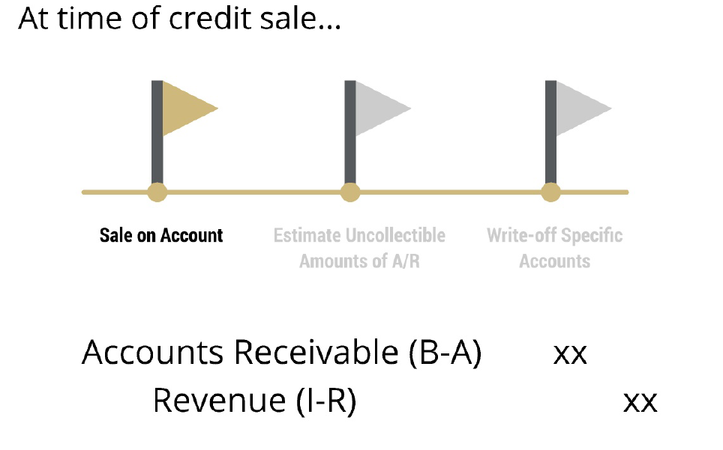
Allowance Method in Detail

Slide 23
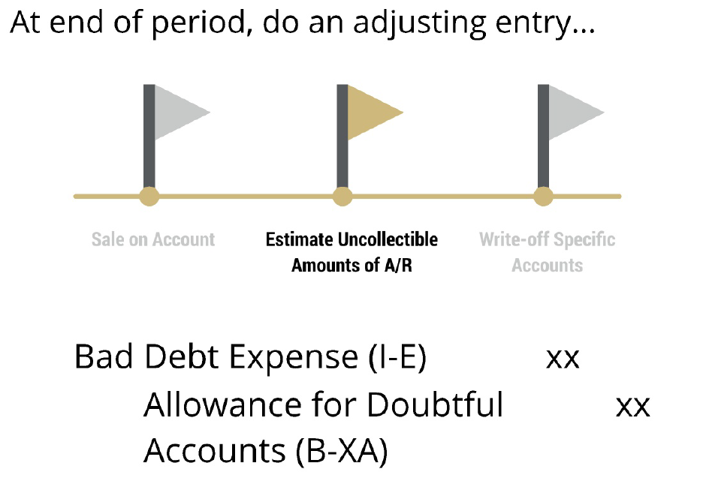
Allowance Method in Detail
This is an ESTIMATE for what won’t be collected. Record expense before we know.

Slide 24
Percentage of Sales
Method 1: Estimate this

Slide 25
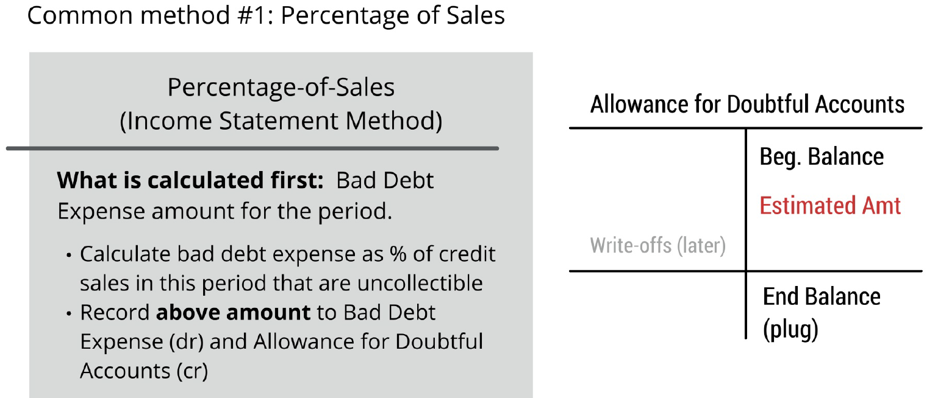
Percentage of Sales

Slide 26
Percentage of Sales

Slide 27
Percentage of Receivables
Method 2: Estimate this

Slide 28
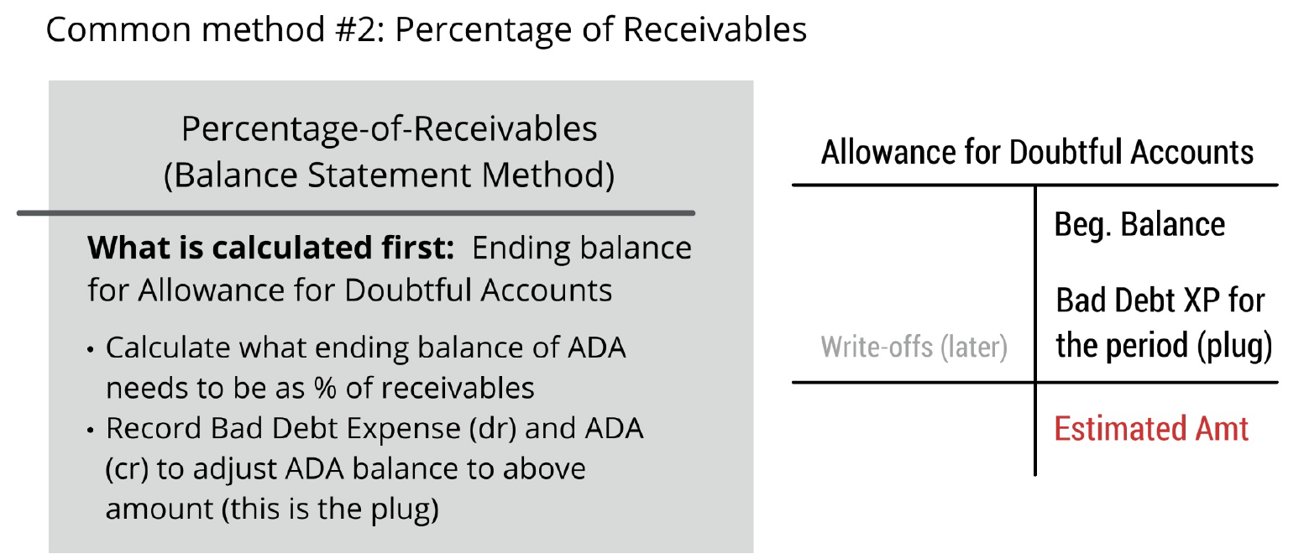
Percentage of Receivables

Slide 29
Summary of methods
Income statement (percentage of sales)
Estimate the BAD DEBT EXPENSE (I/S)
Find the ending allowance balance
Balance sheet (percentage of receivables)
Estimate the Ending ALLOWANCE (B/S)
Plug the bad debt expense
FOCUS for Exam: Percentage of Receivables Method

Slide 30
In-Class Problem
Nemo Co. has the following information during 2024:
Credit sales for the year: $4,000,000
Accounts receivable at 12/31 $543,200
Allowance for doubtful accounts at 12/31, unadjusted $125,000 (credit)
The company estimates expected credit losses as 30% of the accounts receivables balance at the end of the period. Prepare the adjusting journal entry required to record the bad debt provision for the current year. Identify the bad debt expense and ending allowance.
Independent of the above scenario, assume the company estimates aging of account receivables using the following rules for % uncollectible: current: 5%, <30 days past due: 8%, 31-60 days: 10%, 61-90 days: 30%, >90 days: 50%. The aged schedule of receivables is below. Prepare the adjusting journal entry required to record the bad debt provision for the current year.
Days Past Due | Balance
Current | 123,000
< 30 days | 53,000
30-60 days | 60,500
61-90 days | 46,400
>90 days | 260,300

Slide 31
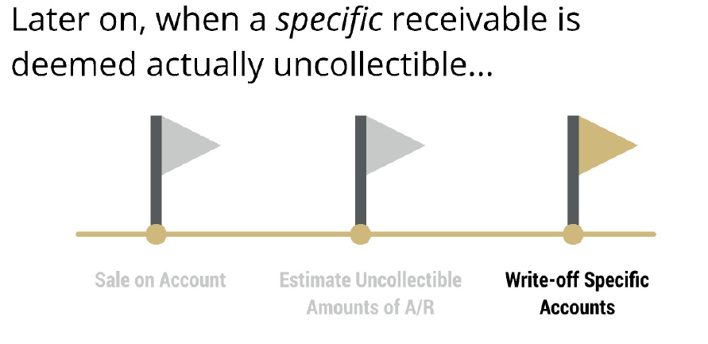
As Time Goes on…
??????

Slide 32
Write Offs
A/R Ledger
Allowance for Doubtful Accounts (B-XA)
Customer Name | Balance Owed
Homer Corp. | 10,000
Shem Manufacturing | 10,000
Miah Inc. | 10,000
…
…
…
Keller Kompany | 10,000
Total | $5,000,000
Customer Name | Uncollectible
??? | (10,000)
??? | (10,000)
Total | (20,000)
Suppose we identify that Miah Inc. won’t pay…

Slide 33
Write Offs
A/R Ledger
Allowance for Doubtful Accounts (B-XA)
Customer Name | Balance Owed
Homer Corp. | 10,000
Shem Manufacturing | 10,000
Miah Inc. | 10,000
…
…
…
Keller Kompany | 10,000
Total | $5,000,000
Customer Name | Uncollectible
??? | (10,000)
Miah Inc. | (10,000)
Total | (20,000)
Assume that Miah was in the allowance…

Slide 34
Write Offs
A/R Ledger
Allowance for Doubtful Accounts (B-XA)
Customer Name | Balance Owed
Homer Corp. | 10,000
Shem Manufacturing | 10,000
Miah Inc. | 10,000
…
…
…
Keller Kompany | 10,000
Total | $4,990,000
Customer Name | Uncollectible
??? | (10,000)
Miah Inc. | (10,000)
Total | (20,000)
Get rid of the A/R…no longer an asset.

Slide 35
Write Offs
A/R Ledger
Allowance for Doubtful Accounts (B-XA)
Customer Name | Balance Owed
Homer Corp. | 10,000
Shem Manufacturing | 10,000
Miah Inc. | 10,000
…
…
…
Keller Kompany | 10,000
Total | $4,990,000
Customer Name | Uncollectible
??? | (10,000)
Miah Inc. | (10,000)
Total | (20,000)
Journal Entry
Cr. Accounts Receivable 10,000
Get rid of the A/R…no longer an asset.

Slide 36
Write Offs
A/R Ledger
Allowance for Doubtful Accounts (B-XA)
Customer Name | Balance Owed
Homer Corp. | 10,000
Shem Manufacturing | 10,000
Miah Inc. | 10,000
…
…
…
Keller Kompany | 10,000
Total | $4,990,000
Customer Name | Uncollectible
??? | (10,000)
Miah Inc. | (10,000)
Total | (10,000)
Journal Entry
Cr. Accounts Receivable 10,000
Get rid of the associated allowance (if the asset is gone, don’t need a reserve against it).

Slide 37
Write Offs
A/R Ledger
Allowance for Doubtful Accounts (B-XA)
Customer Name | Balance Owed
Homer Corp. | 10,000
Shem Manufacturing | 10,000
Miah Inc. | 10,000
…
…
…
Keller Kompany | 10,000
Total | $4,990,000
Customer Name | Uncollectible
??? | (10,000)
Miah Inc. | (10,000)
Total | (10,000)
Journal Entry
Dr. Allowance 10,000
Cr. Accounts Receivable 10,000
Remove the associated allowance (if the asset is gone, don’t need a reserve against it).
Note: There is no Expense!

Slide 38
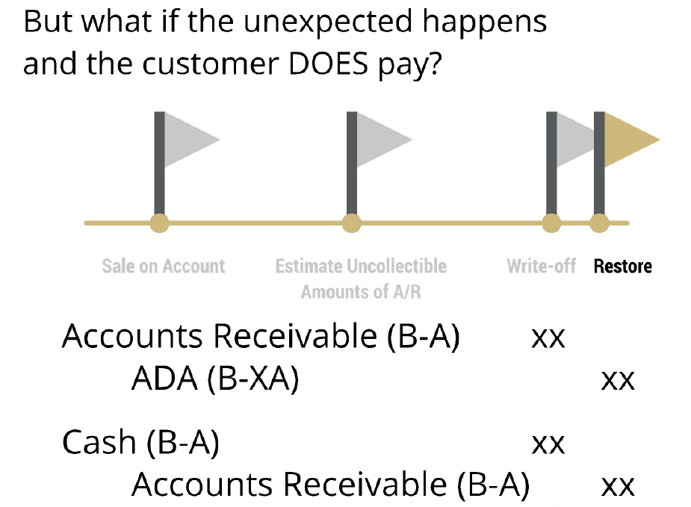
Payment after write off?
Reverse the write-off

Slide 39
Payment after write off?
Collect cash

Slide 40
Go to handout…
Problem #2
Problem #3

Slide 41
Closing Thoughts
Accounts Receivable is reported at the net realizable value (what will be collected)
Net realizable value is a combination of two accounts:
Accounts receivable (asset, what you are owed)
Allowance for doubtful accounts (contra-asset, estimate of what you won’t collect)
Write-offs do not affect the income statement or the net realizable value of A/R

